Slide 1
POWER BI REINFORCEMENT PROJECT Car Price Analysis
PRESENTED BY
GOWTHAM S
DA & DS
FEB-2025

Slide 2
PROJECT OBJECTIVE
Explore and analyze used car lists
Identify the price patterns by brand, year, fuel type, and condition
Source : Raw dataset loaded into Power BI
Use Power BI for complete data modeling, DAX, and visualization
Contains 2,500 rows and 10 columns

Slide 3
DATA PREPARATION IN POWER QUERY
Transform a data and cleaned by using Power Query
Removed nulls & duplicates
Ensured correct data types
No external Excel transformation used

Slide 4
DAX MEASURES
Total Price
Average Price
Average Mileage
Maximum Price
Minimum Price
Car Count

Slide 5
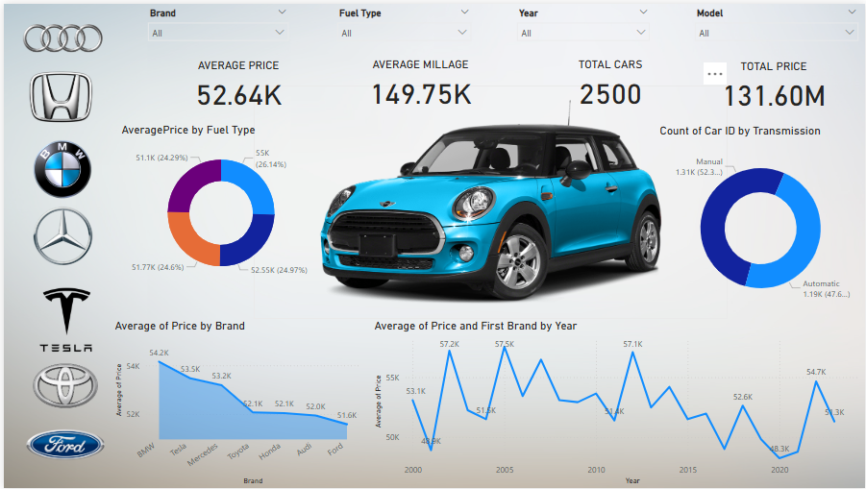

Slide 6
KEY INSIGHTS
Brands like BMW have the highest average prices
Diesel is the most commonly used (26.2%)
Petrol, Hybrid, and Electric each contribute nearly 24–25%
New cars are priced significantly higher
Average price peaked in 2003, 2006 and 2012
Used cars show highest average mileage (168.26K)

Slide 7
CONCLUSION
Key Insights: Fuel type and car condition affect price and mileage. Diesel cars are most common, and used cars have the highest mileage.
Price Trends: Car prices fluctuate over the years, with peaks in 2003, 2006, and 2012.
Brand Insights: Toyota has the highest car count, while Ford has the lowest, with a balanced presence across brands.

Slide 8
THANK YOU

